Slide 2
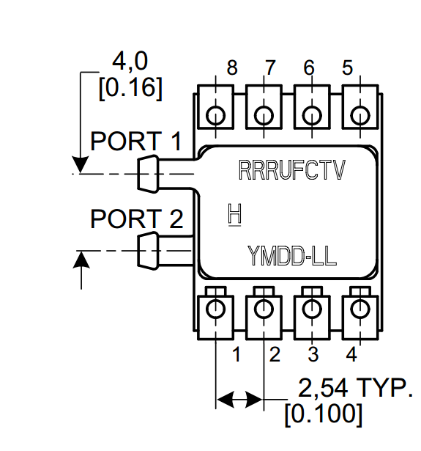
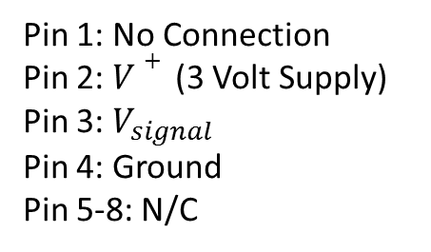
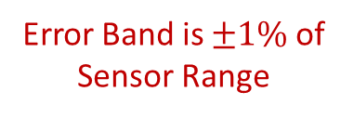
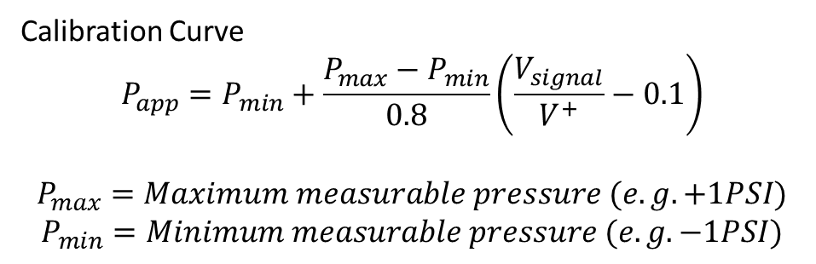
Honeywell HSCDRRN010MDAA3 Pinouts and Calibration
Sensor Range is +/- 10 millibar
(+/- 1,000 Pascals)
Pin 1: No Connection
Pin 2: $V+$ (3 Volt Supply)
Pin 3: $V_{signal}$
Pin 4: Ground
Pin 5-8: N/C
Error Band is $±1\%$ of Sensor Range
Calibration Curve
$$P_{app}=P_{min}+\frac{P_{max}−P_{min}}{0.8}\left(\frac{V_{signal}}{V^{+}}−0.1\right)$$
$$P_{max}=Maximum measurable pressure (e.g. +1PSI)$$
$$P_{min}=Minimum measurable pressure (e.g. −1PSI)$$

Slide 3
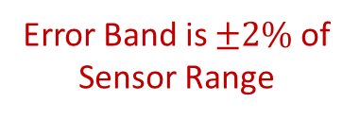
Honeywell HSCDRRN001NDAA3 Pinouts and Calibration
Sensor Range is
+/- 1 inches water column
(+/- 248.84 Pascals)
Pin 1: No Connection
Pin 2: $V+$ (3 Volt Supply)
Pin 3: $V_{signal}$
Pin 4: Ground
Pin 5-8: N/C
Error Band is $±2\%$ of Sensor Range
Calibration Curve
$$P_{app}=P_{min}+\frac{P_{max}−P_{min}}{0.8}\left(\frac{V_{signal}}{V^{+}}−0.1\right)$$
$$P_{max}=Maximum measurable pressure (e.g. +1PSI)$$
$$P_{min}=Minimum measurable pressure (e.g. −1PSI)$$

Slide 4
Honeywell SSCDRRNxxxKDAA3 Pinouts and Calibration
Sensor Range
Pin 1: No Connection
Pin 2: $V+$ (3 Volt Supply)
Pin 3: $V_{signal}$
Pin 4: Ground
Pin 5-8: N/C
Calibration Curve
$$P_{app}=P_{min}+\frac{P_{max}−P_{min}}{0.8}\left(\frac{V_{signal}}{V^{+}}−0.1\right)$$
$$P_{max}=Maximum measurable pressure (e.g. +1PSI)$$
$$P_{min}=Minimum measurable pressure (e.g. −1PSI)$$

Slide 5
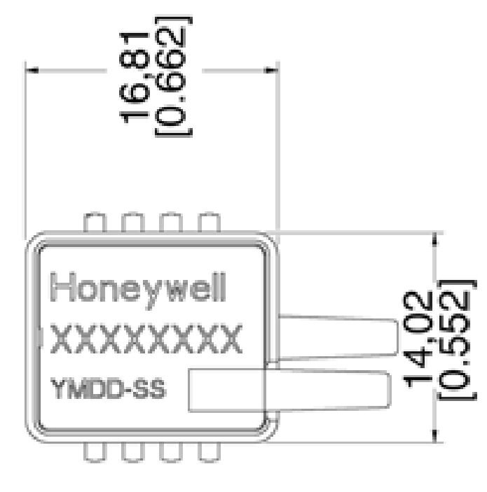
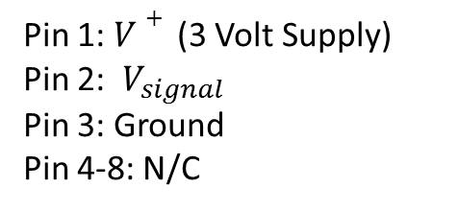
Honeywell ASDXRRxxxPGAA3 Pinouts and Calibration
Sensor Range
Pin 1: $V+$ (3 Volt Supply)
Pin 2: $V_{signal}$
Pin 3: Ground
Pin 4-8: N/C
1 2 3 4
8 7 6 5
Calibration Curve
$$P_{app}=P_{min}+\frac{P_{max}−P_{min}}{0.8}\left(\frac{V_{signal}}{V^{+}}−0.1\right)$$
$$P_{max}=Maximum measurable pressure (e.g. +1PSI)$$
$$P_{min}=Minimum measurable pressure (e.g. −1PSI)$$

Slide 6
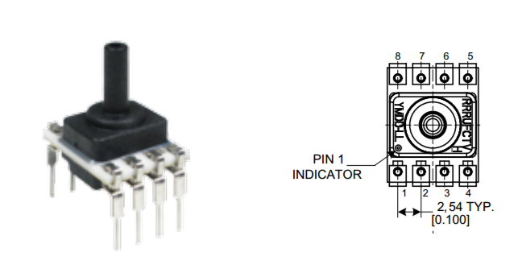
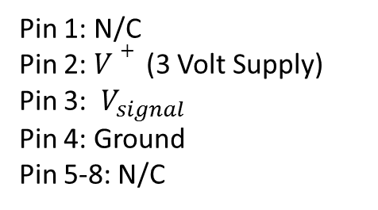
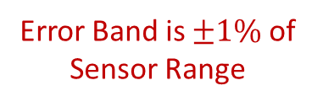
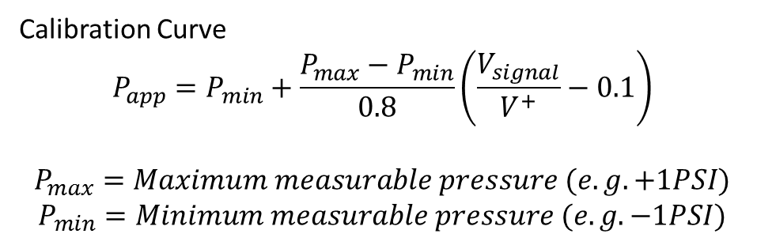
Honeywell HSCDLNN001PDAA3 Pinouts and Calibration
Sensor Range: +/- 1 PSI
(+/- 6894.76 Pascals)
Pin 1: N/C
Pin 2: $V+$ (3 Volt Supply)
Pin 3: $V_{signal}$
Pin 4: Ground
Pin 5-8: N/C
Error Band is $±1\%$ of Sensor Range
Calibration Curve
$$P_{app}=P_{min}+\frac{P_{max}−P_{min}}{0.8}\left(\frac{V_{signal}}{V^{+}}−0.1\right)$$
$$P_{max}=Maximum measurable pressure (e.g. +1PSI)$$
$$P_{min}=Minimum measurable pressure (e.g. −1PSI)$$

